Slide 1
Otter
Week 6 - Ian M, Sonia V, Gustavo C

Slide 2
Roadmap:
Value Proposition
Tasks
Redesigned screens
Medium-fi task flows
Prototype

Slide 3
Value Proposition
Problem
Solution
Reflect/Reconnect.
Individuals don’t have an opportunity to reflect and practice habits that benefit their mental health.
Otter - Chance to regularly reflect and creates practices for mental health.
Notes:
-Relying on Donnovan Yisrael’s quote about how society codes ‘mental health’ for ‘mental illness’, whereas ‘mental health’ is actually ‘what you do to be and stay healthy’
-Our problem domain we hope to explore the practices of people when they engage with mental health, and we ultimately hope to learn about any and all underlying issues that are the source of mental health practices.
-Our assumptions is that people have mental health goals that are not being met by their practices resulting in suboptimal mental health status. We had great success in hearing from a diverse group including extreme, average and non-users. The feedback that we received from our first week was to 1) explore why non-users are not as engaged with mental health practices 2) explore tension of wanting to seek mental health help but being discouraged. We aimed to explore those topics this week, as well as develop HMW from our first week interviews and conduct experience prototypes.

Slide 4
Tasks
Simple: Send a message to Otter.
Moderate: Do an action that helps with mental health.
Complex: Set a goal for a practice that positively impacts mental health.

Slide 5
Change #1: Revised home screen

Slide 6
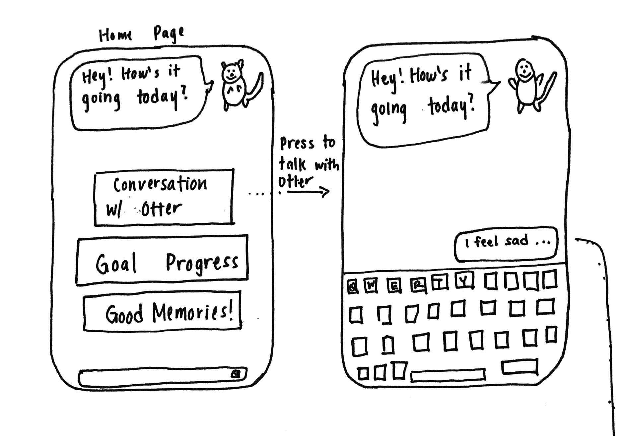
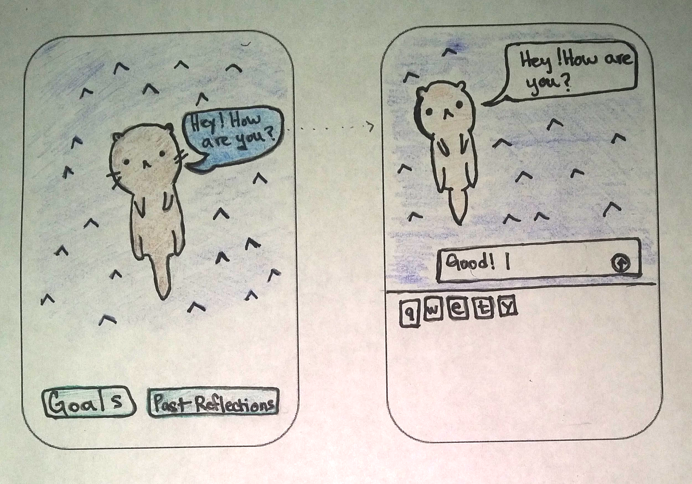

Slide 7
Change #2: Clearer labels

Slide 8
Change #3: Navigation issues

Slide 9
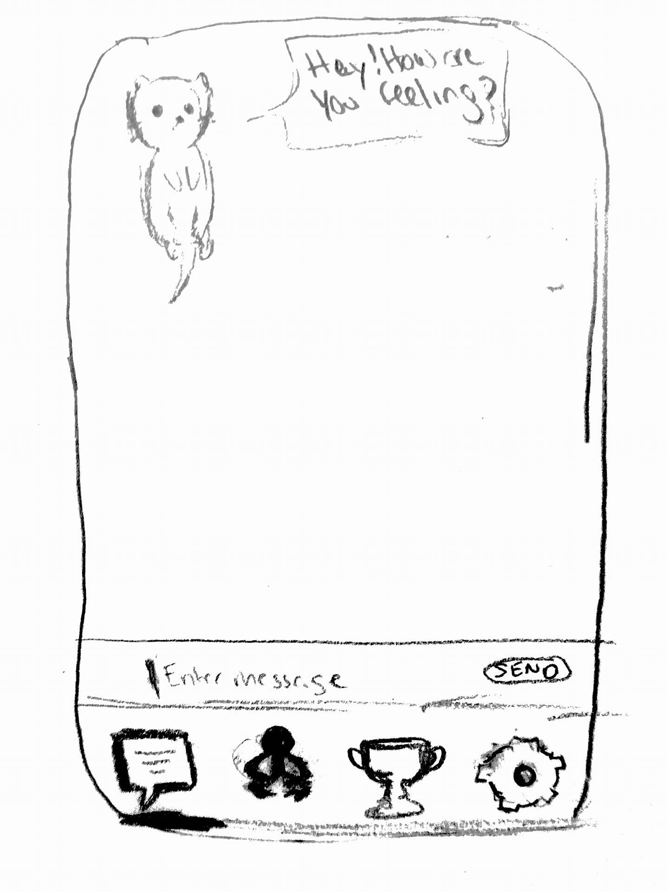

Slide 10
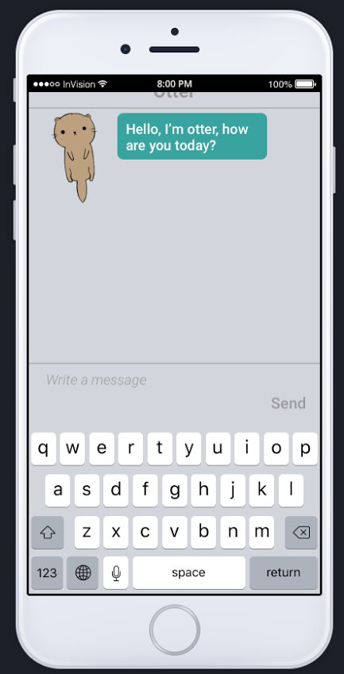
Task 1:
Send otter a message

Slide 11
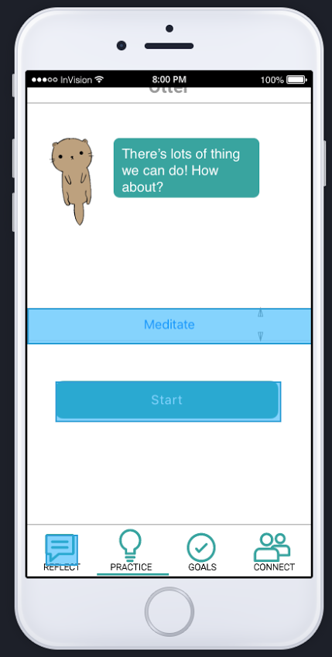
Task 2:
Do an action that helps
with mental health

Slide 12
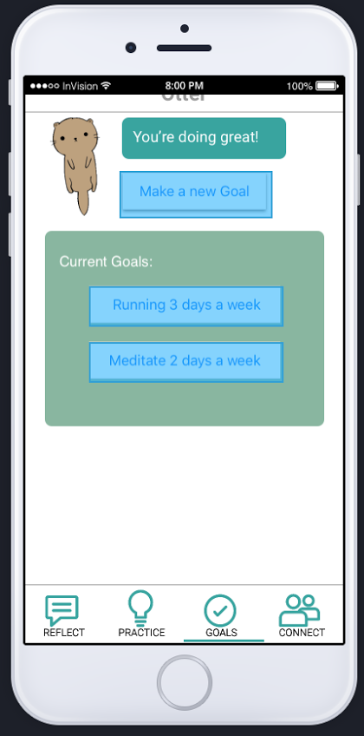
Task 3:
Set a goal for a practice
that positively impacts
mental health

Slide 13
Prototype
Tools Used: Sketch and invision.
Limitations:
Screens not related to tasks are not shown
Limited Actions (eg: Meditate,nap)
No animation of Otter

Slide 14
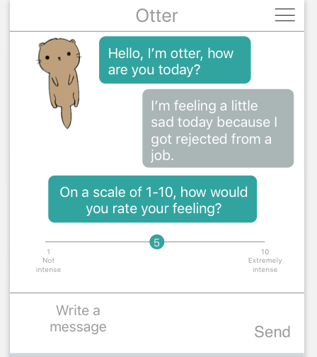
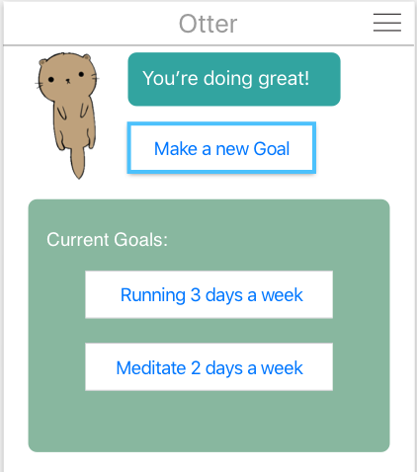
Prototype
Hard Coded Features
Previous Goals
Otter and user conversations (Wizard of Oz)

Slide 15
Summary:
Interviews revealed that mental health is highly varied for individuals
HMW keep track of stories, provide personalized info and destigmatize mental health within specific cultures?
The experience prototypes showed that users were more reflective when given a chance

Slide 16
Thanks!
Any questions ?
Email us at:
imacato@stanford.edu
svela7@stanford.edu
gachavez@stanford.edu

